Slide 1
STRESS DETECTOR AND REDUCER WEARABLE DEVICE USING IOT
Team Members
Monica V (211417104151)
Sabarna Barhan Z(211417104228)
Madhusri V(211417104138)
GUIDE
Dr.L.Jaba Sheela,
Professor, Department of CSE
BATCH-15
DEPARTMENT OF CSE

Slide 2
INTRODUCTION
Stress detection and reduction are the proceeding analysis subject among researchers. Diversity automation evolves on person stress detection and reduction using wearable sensors.
The main objective of stress detector and reducer wearable device using IoT is to significantly find the stress in human being and reduce it.
Our system predicts the human stress level using heartbeat, skin respiration rate and pulse rate, once stress is detected then immediately it will switch on the IR LED which is will reduce the stress through light waves penetration.
To overcome the disadvantage in the existing system we are going to propose this automation detection and reduction system.Our system is cost efficient compare to all the other existing systems.

Slide 3
LITERATURE SURVEY
Year of Passing | Author Name | Title | Advantage | Disadvantage
2020 | Nurdina Widanti; Budi Sumanto; Poppy Rosa; M. Fathur Miftahudin | Automatic Stress Detection Using Wearable Sensors and Machine Learning: A Review | Detecting Stress of an individual with the help of wearable sensors and machine learning algorithms are effective and affordable | Used multiple features correlated with each other increases computation time and used some costly commercial devices for physiological signal collection.
2019 | Murat Yuksel; Wei Wang; Shafaq Chaudhry; Damla Turgut; Naim Kapucu | Challenges and Opportunities in Utilizing IoT-Based Stress Maps as a Community Mood Detector | a time series of national maps of happiness and negative Emotions | Need to aggregate data and transfer it with a high enough frequency to adhere to the real-time nature of collecting and monitoring stress data.
2019 | Bhagyashree Shirke; Jonathan Wong; Kiran George | Acute Mental Stress Measurement using Brain-IoT System | Non-invasive method for individuals to diagnose and cope with their stress levels | reading may be slightly inaccurate by EEG headset due to the inference of the hair and high sensitivity to muscle movement
2018 | Vasilii G. Arkhangelsky Sergey A. Alyushin Alexander V. Alyushin | Development and Analysis of Analog-Digital Neural Net for Speech Stress Detection | Supports self-organization process in speech stress detection during speech analysis | Cannot able to detect stress by body condition.
2018 | Laavanya Rachakonda; Prabha Sundaravadivel; Saraju P. Mohanty; Elias Kougianos; Madhavi Ganapathiraju | A Smart Sensor in the IoMT for Stress Level Detection | Monitors stress levels through body temperature, rate of motion and sweat during physical activity | Detects stress only through physical activities.

Slide 4
PROBLEM STATEMENT
Stress has become ingrained part of our life, being stressed by our tension and worries.
Stress causes physical illnesses, such as heart attacks, arthritis, and chronic headaches or psychological diseases like mental illness, anger, anxiety, and depression.
There are several research works coming up to resolve the limitations on measuring, analyzing and identifying the human stress levels
Amongst the many stress monitoring method the more reliable method to determine the human stress level is to use physiological signals.
It is very important to understand the stress status of a person much before the stress starts to cause some adverse effects on our body.
The main purpose of this work is to develop a continuous stress monitoring system and thereby reduce the effects of stress on mental health as well as physical health of a person.
Our Proposed system detects the stress occurring using the heartbeat rate, skin resistance and pulse rate and it reduces the stress using IR LED light penetration.

Slide 5
TECHNOLOGY STACK
SOFTWARE REQUIREMENT
Front End
HARDWARE REQUIREMENT
Microcontroller
Galvanic Sensor
Heart rate Sensor
ECG
IR LED
Mobile Phone
Power Supply
Arduino IDE
Wamp server
Android Studio
Back End
My Sql
PHP

Slide 6
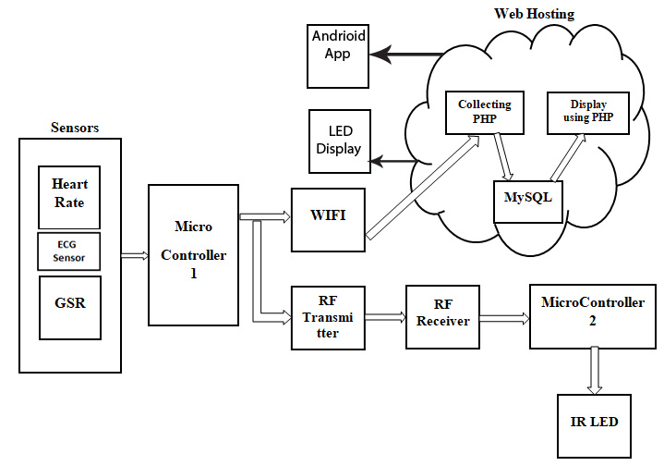
SYSTEM ARCHITECTURE

Slide 7
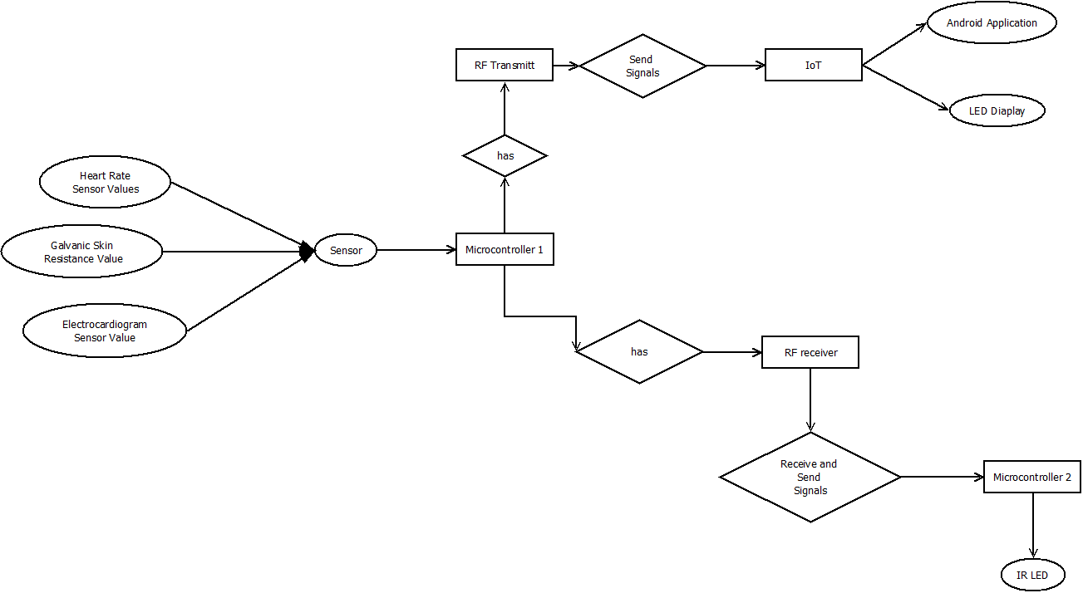
SYSTEM DESIGN
ER DIAGRAM

Slide 8
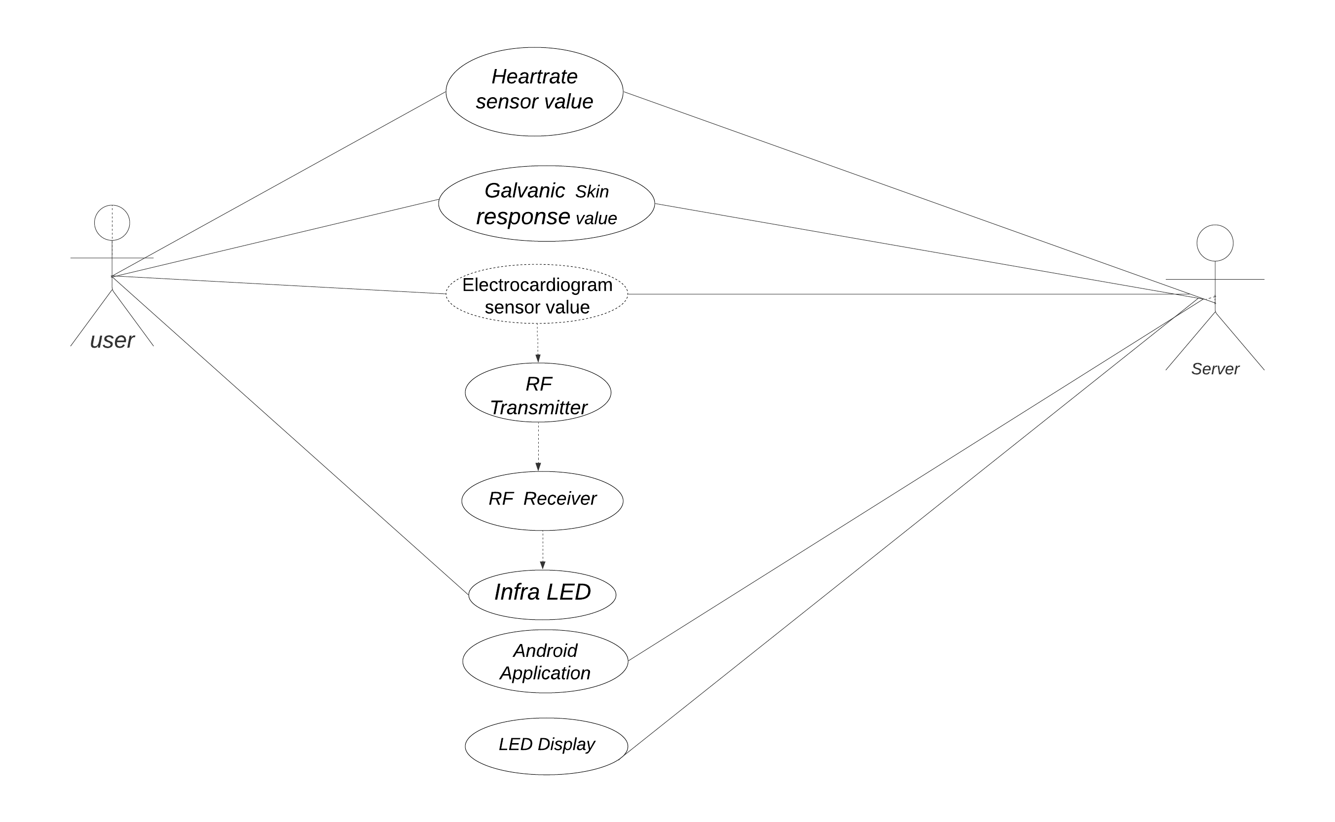
USECASE DIAGRAM

Slide 9
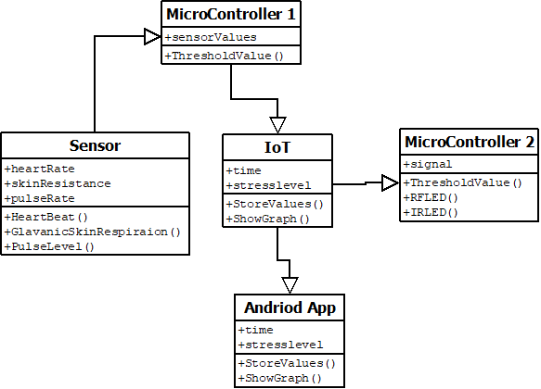
CLASS DIAGRAM

Slide 10
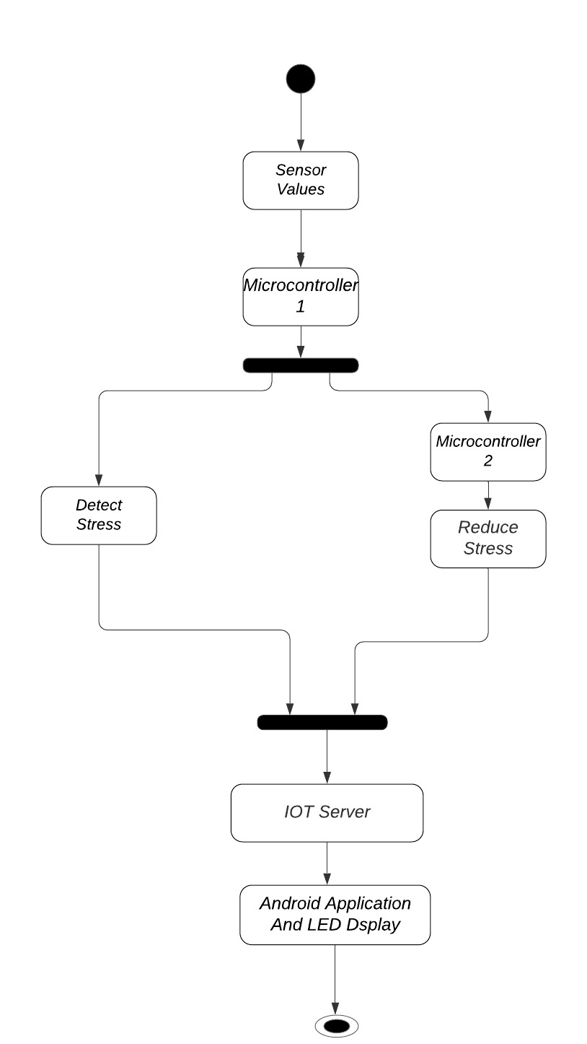
ACTIVITY DIAGRAM

Slide 11
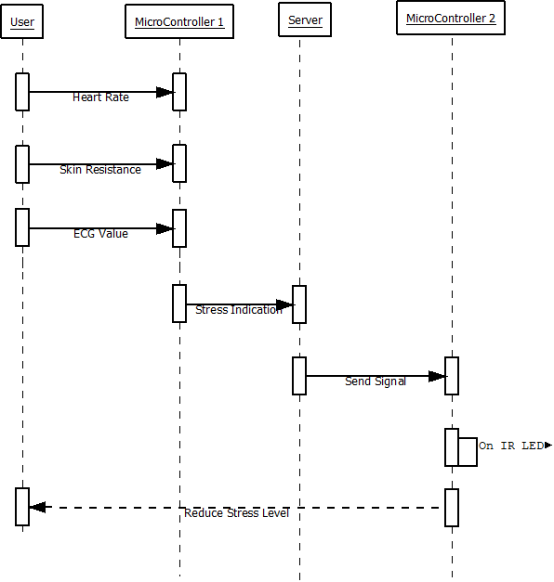
SEQUENCE DIAGRAM

Slide 12
MODULES
Detecting Stress
Stress Indication In Online
Reducing stress

Slide 13
MODULE DESCRIPTION
DETECTING STRESS
Heartbeat level and pulse rate increases during stress, here we monitor the heartbeat rate using heartbeat sensor and pulse rate using ECG sensor.
Stress causes sweating to increase on palms and soles. Changes in the rate of sweat it increases the skin resistance.
Using GSR sensor we are checking the skin resistance level.
When the sensor values exceeds threshold values stress in the user is detected and sent to Microcontroller (Arduino).

Slide 14
MODULE DESCRIPTION
STRESS INDICATION IN ONLINE:
Once Microcontroller receives the stress indication it automatically sends the time when it got the indication and how many times stress has been detected to the Internet of things [IoT] server through WIFI module.
Those indications will be stored in the online and can be viewed whenever needed. And also they can check it in their mobile phones through android app. It will be helpful for the user to take medication.

Slide 15
MODULE DESCRIPTION
REDUCING STRESS
Stress Indication is done in the first Microcontroller using sensors and sends wireless signal to the RF Receiver in the second Microcontroller through RF Transmitter.
Once the signal is received in second microcontroller, it will switch on the IR LED to reduce the stress level which is attached in the user toe.

Slide 16
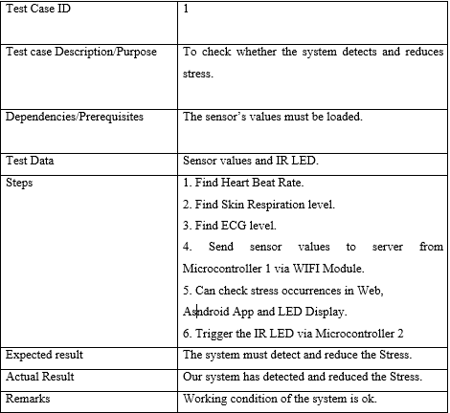
SAMPLE TEST CASES

Slide 17
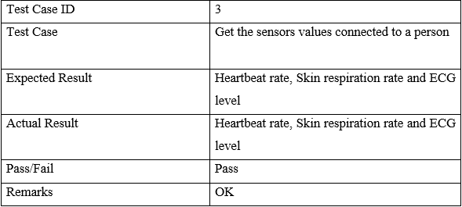
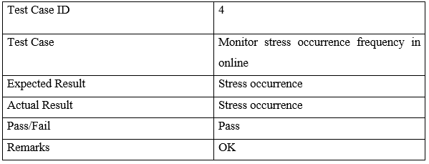
TEST REPORT
DETECTING STRESS
STRESS INDICATION IN ONLINE

Slide 18
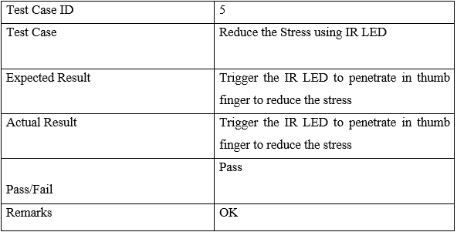
TEST REPORT
REDUCING STRESS

Slide 19
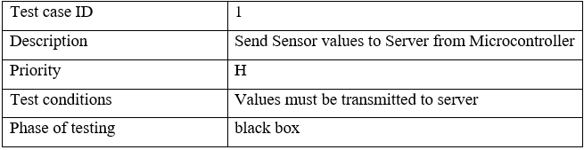
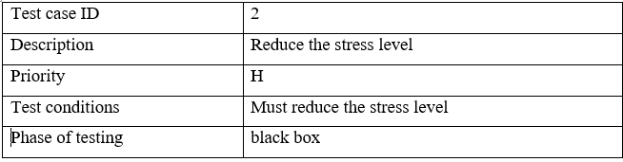
TRACEABILITY MATRIX REPORT

Slide 20
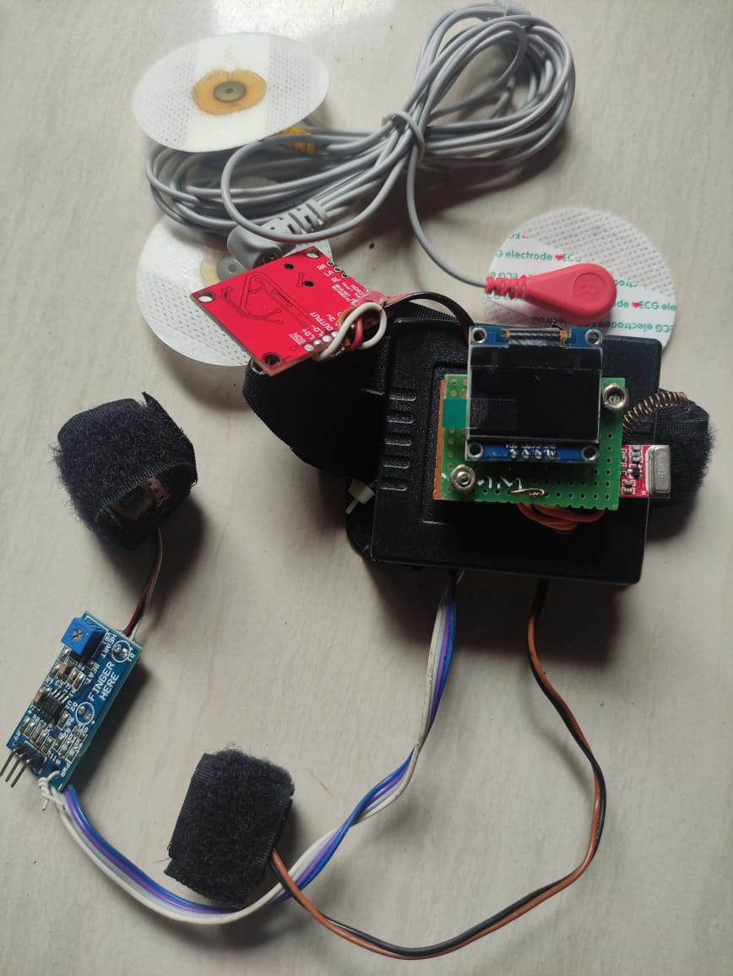
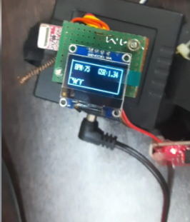
SCREENSHOTS

Slide 21
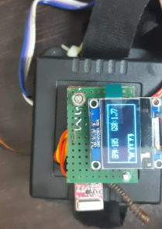
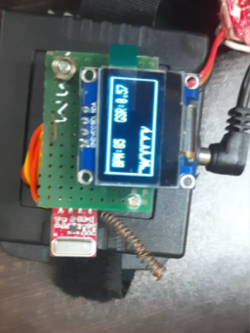
SCREENSHOTS

Slide 22
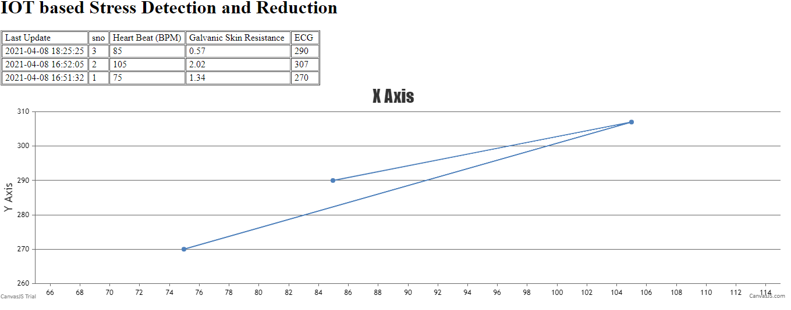
SCREENSHOTS

Slide 23
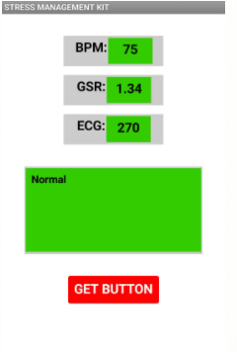
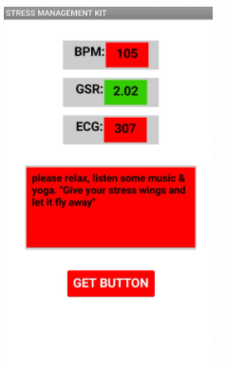
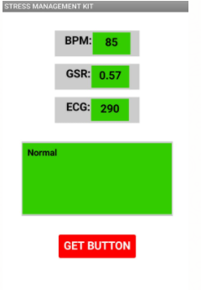
SCREENSHOTS

Slide 24
CONCLUSION
We developed a stress detection scheme to be used in real life. Since our system employs unobtrusive wearable devices, it can easily be used in the daily life of individuals.
IOT includes a wide range of sensors where in edge computations are performed. The main objective of stress detector and reducer wearable device using IoT is to significantly find the stress in human being and reduce it.
It can track the stress in real-time and intervene if an extreme of stress is detected.
After the detection, some stress management methods can also be offered to alleviate the high level of stress.
We can enhance our proposed system to monitoring the level of stress in particular time.

Slide 25
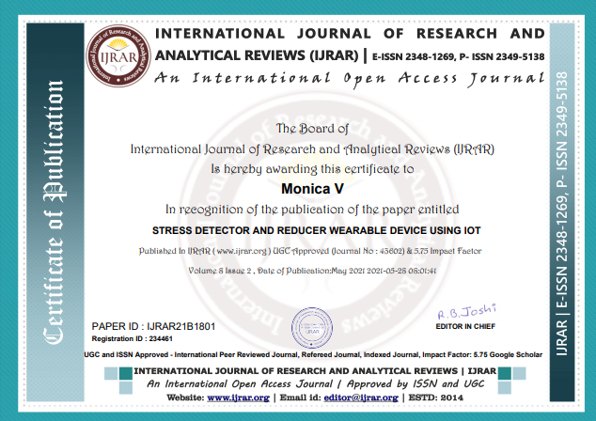
PUBLICATIONS
Journal name- International Journal Of Research And Analytical Reviews
Paper title- Stress Detector and Reducer Wearable Device Using IOT
Publication issue -Volume 8, Issue 2, May – 2021

Slide 26
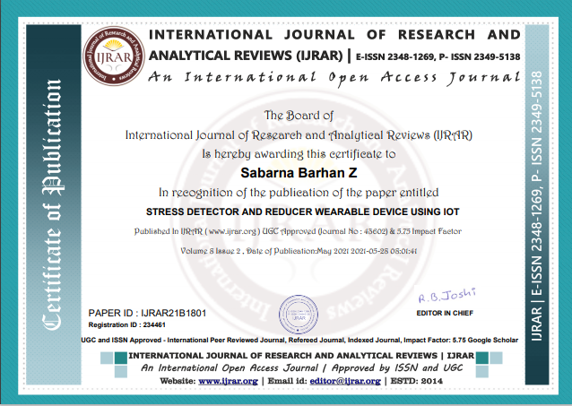


Slide 27
REFERENCES
[1]Nurdina Widanti; Budi Sumanto; Poppy Rosa; M. Fathur Miftahudin Automatic Stress Detection Using Wearable Sensors and Machine Learning: A Review,2020.
[2]Murat Yuksel; Wei Wang; Shafaq Chaudhry; Damla Turgut; Naim KapucuChallenges and Opportunities in Utilizing IoT-Based Stress Maps as a Community Mood Detector,2019.
[3]Bhagyashree Shirke; Jonathan Wong; Kiran George. Acute Mental Stress Measurement using Brain-IoT System ,2019.
[4]Vasilii G. Arkhangelsk Sergey A. Alyushin Alexander V. AlyushinDevelopment and Analysis of Analog-Digital Neural Net for Speech Stress Detection,2018.
[5]LaavanyaRachakonda;PrabhaSundaravadivel;SarajuP. Mohanty; Elias Kougianos; Madhavi Ganapathiraju. A Smart Sensor in the IoMT for Stress Level Detection,2018.

